Slide 1

Console Game Help
Turn on Audio if you want narration
Notes:
By this point you should know the drill, this help file is about the console game.

Slide 2
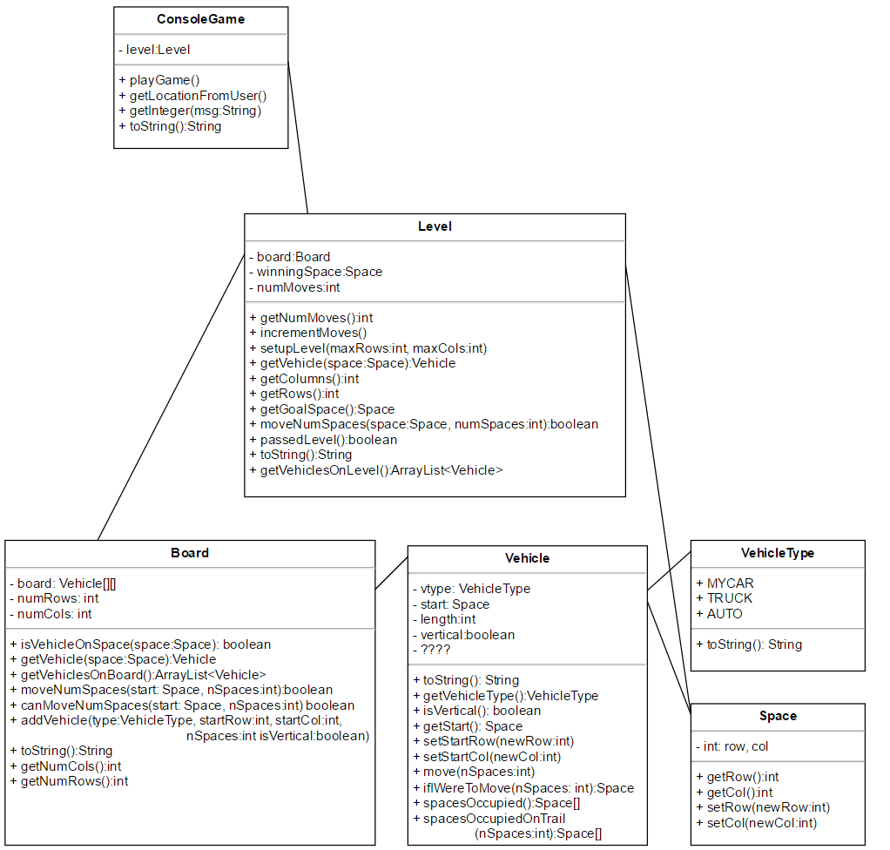
Difficulty with this assignment
Notes:
Really the difficult portion of this assignment is making sure you understand how everything works together, so I would encourage you to go back and look at the diagram on this slide to study how all the methods and classes are working in conjunction with each other. I’ve gone ahead and pasted it here, but what I’m showing you is an example of what is typically called a UML diagram, where you can get an idea of what each class is going to have, without having written all of the parts of that assignment.

Slide 3
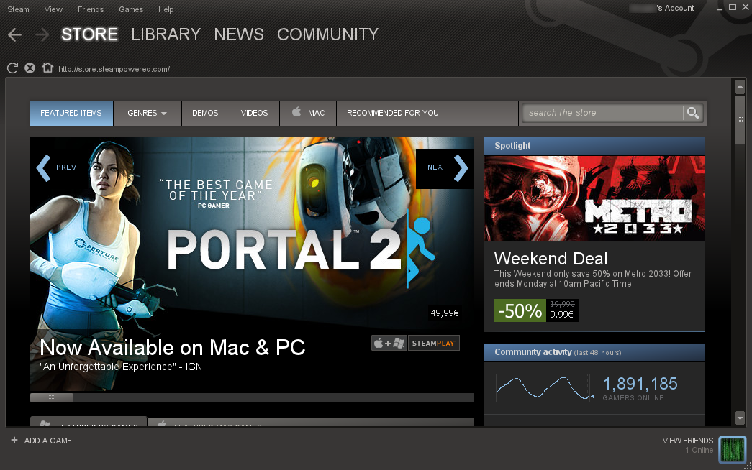
Level’s role
Notes:
I think the most confusing part of this assignment is the role of level. To help answer that I want you to think of Level as sort of the middle man between the game and the board class. The best analogy that I can come up with about Level is to think of it as the steam store. For those of you that are unaware, steam can be thought of as a marketplace where you are able to purchase games from a variety of different publishers. Buying the publisher’s games via steam is convenient since you can buy the games on steam instead of going to each website for each game you are interested in purchasing. In that way, I would say that Steam acts as the middle man. Sometimes that may mean that when you purchase a game via steam, steam may just turn around and purchase the game from the publisher’s website, which may be more inefficient, but that makes it convenient for you, since you just have to deal with steam.

Slide 4
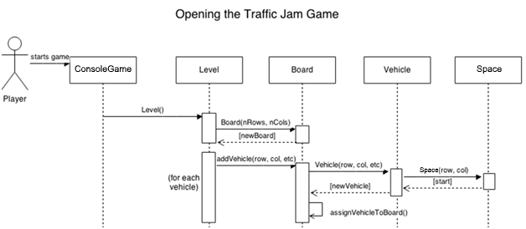
Level is like Steam
Notes:
That’s how I want you to think of level, it’s just the middle man between the game and the board, so that the game only has to communicate with the level and no one else. Level will simply contain a board and oftentimes will turn around and ask the board to do something instead of handle it itself. You’ll notice that there are many methods that look exactly the same between the Level and Board, and that’s OK. Those should be clues to methods that the Level should just turn around and ask the board to do for it instead or rewriting that code itself. There are two additional things that Level is responsible for, which are setting up the board with the Vehicles that we would like, like is shown in this diagram, and to keep track of where the winning space on this particular Level is. If you find yourself doing anything extremely complicated in Level or if you have any questions about ConsoleGame, make sure to email me. Good luck!

